Slide 1
Electronic Shopping Mall System

Slide 2
Table of Content
1
2
Introduction
Work Segregation
3
4
JavaEE Concept
Requirement Analysis
&
Design
5
Recommendation
&
Conclusion

Slide 3
Electronic Shopping Mall System
An online shopping website sells various types of programming related textbooks.
Front-end & Back-end
User-Friendly
Design
Foreground
&
Background
MVC Design Pattern
Java EE

Slide 4
FANG TIANYU | TANG JIACHENG | HUANG YUXIN
Project Import and modify the basic framework of foreground and background. Background user modification Product preview, detail Delivery address modification Header and footer Layout adjustment Bug fixes Database: esm_user, esm_address Report Abstract Introduction Sequence diagram: personal center, order management Package diagram: MVC pattern Database relation diagram Recommendation and conclusion | Project Background category management Database Design: esm_order, esm_orderitem, esm_cart, esm_category User registration User Center Check out process Shopping Cart management Address management Order preview, detail, search, management Book search function Homepage layout design Bug fixes Report Java EE concept Sequence diagram: user log in, check out Use case diagram | Project: Background book management Pagination Customer login, logout Admin login, logout Add product Database: esm_product Collect image, title, and other information of the books Report: Requirement analysis User case diagram Sequence diagram: book display, cart management

Slide 5
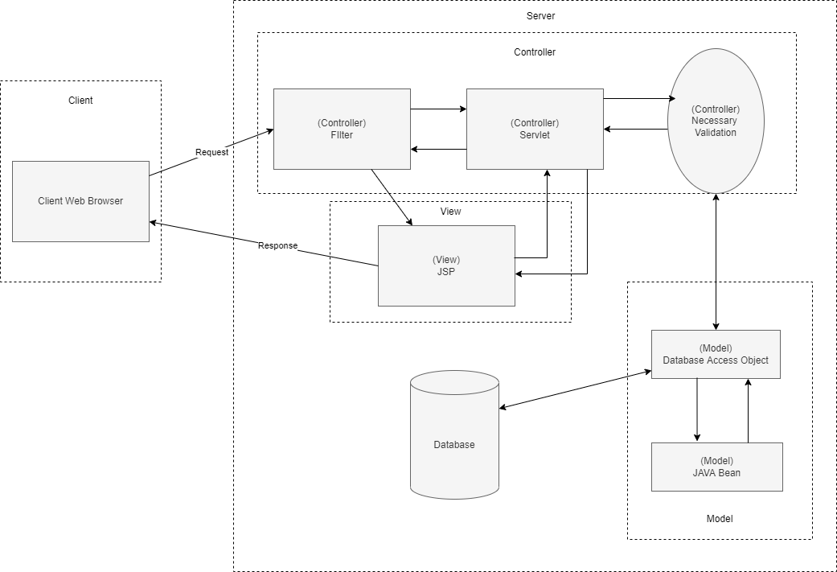
E-shop Architecture
Model Layer
The model layer is the data layer that contains the business logic of the system, and also represents the state of the application. In this project, we used JAVA bean to encapsulate database objects and designed one extra DAO layer that is responsible for interacting with the database.
Controller Layer
Servlet plays the role of Controller. It receives requests from the view layer and processes them, also including some necessary validations, like checking if the user have inputted necessary information.
View Layer
The View layer (JSP) defines the presentation layer of the web application, displaying the model data fetched by the controller.

Slide 6
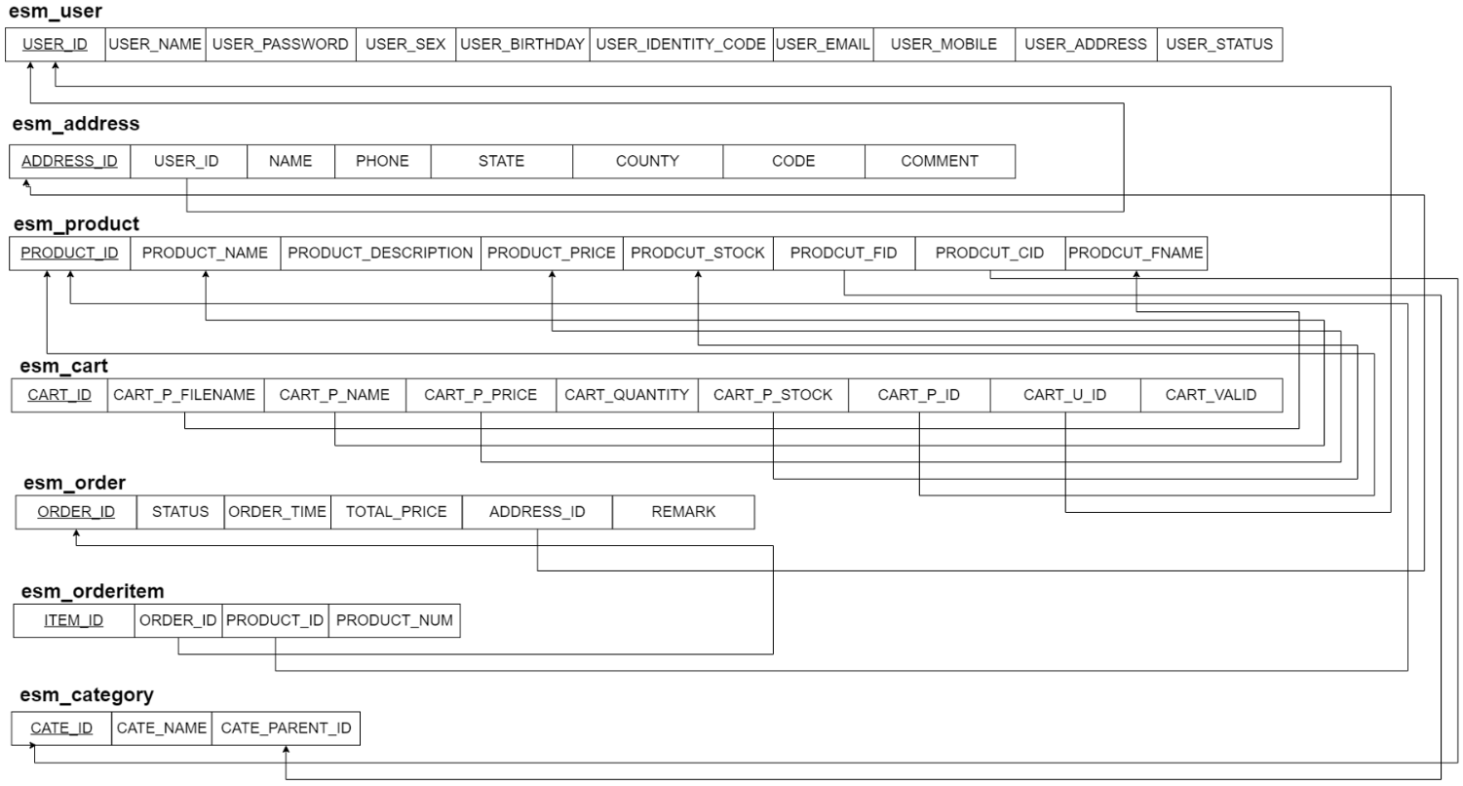
Foreground Requirement
User Login
Personal Center
Book Display
Order Management
Cart Management
Check Out

Slide 7
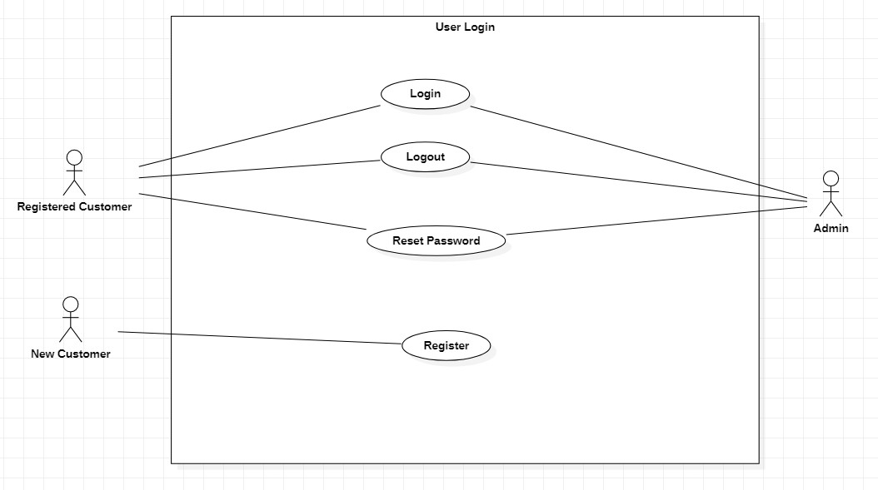
User Login
Both registered customer and admin can login, logout and reset password.
New Customer can register and after registration, he/she can become a registered customer and do according activities.

Slide 8
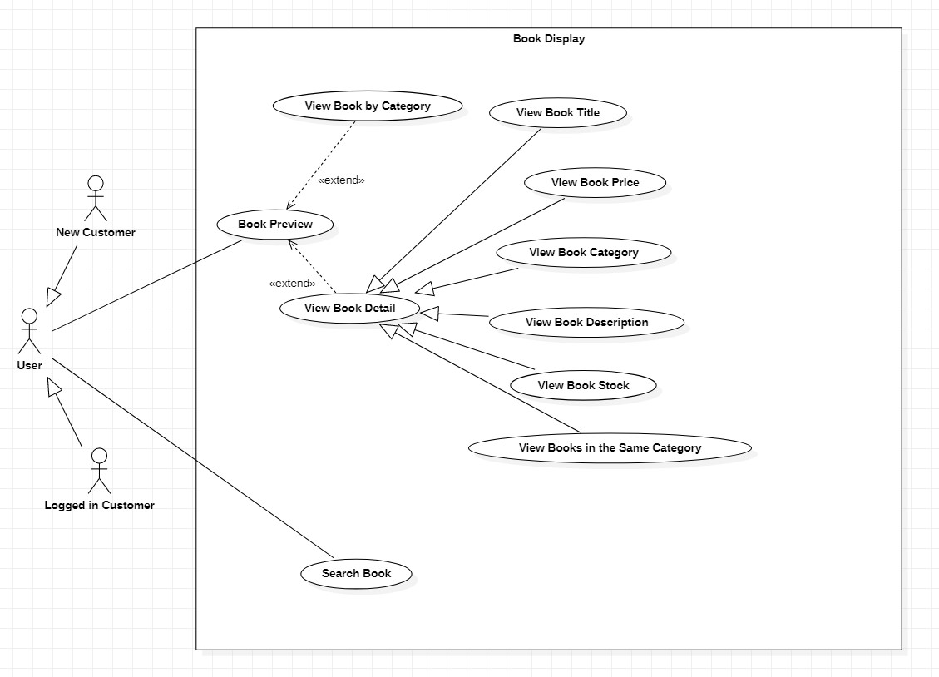
Book Display
Both logged in customer and new customer can search book and preview book. They can choose to view book by category and view book details including the title, price, category, description, stock of book and also books in the same category.

Slide 9
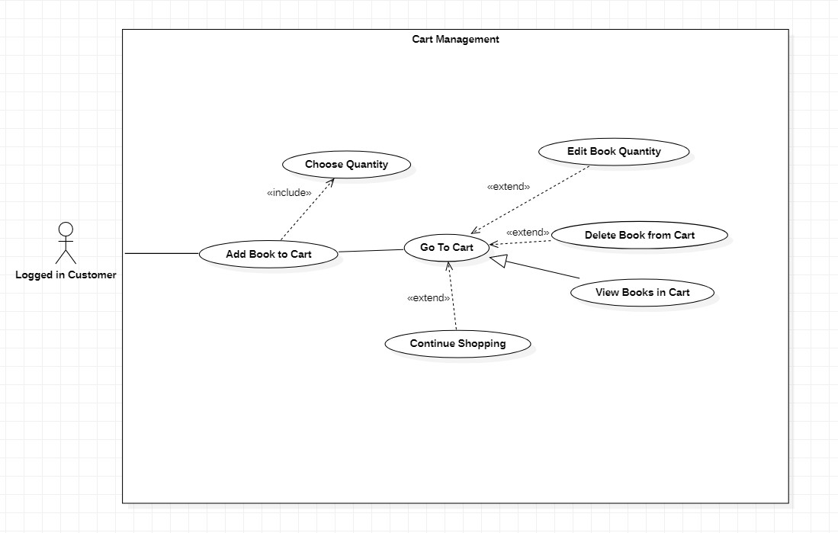
Cart Management
Only logged in customer can manage cart. He/she must choose book quantity first and only then can add book to cart. Then logged in customer can go to cart and view books in cart. They can choose to edit book quantity, delete book from cart or continue shopping.

Slide 10
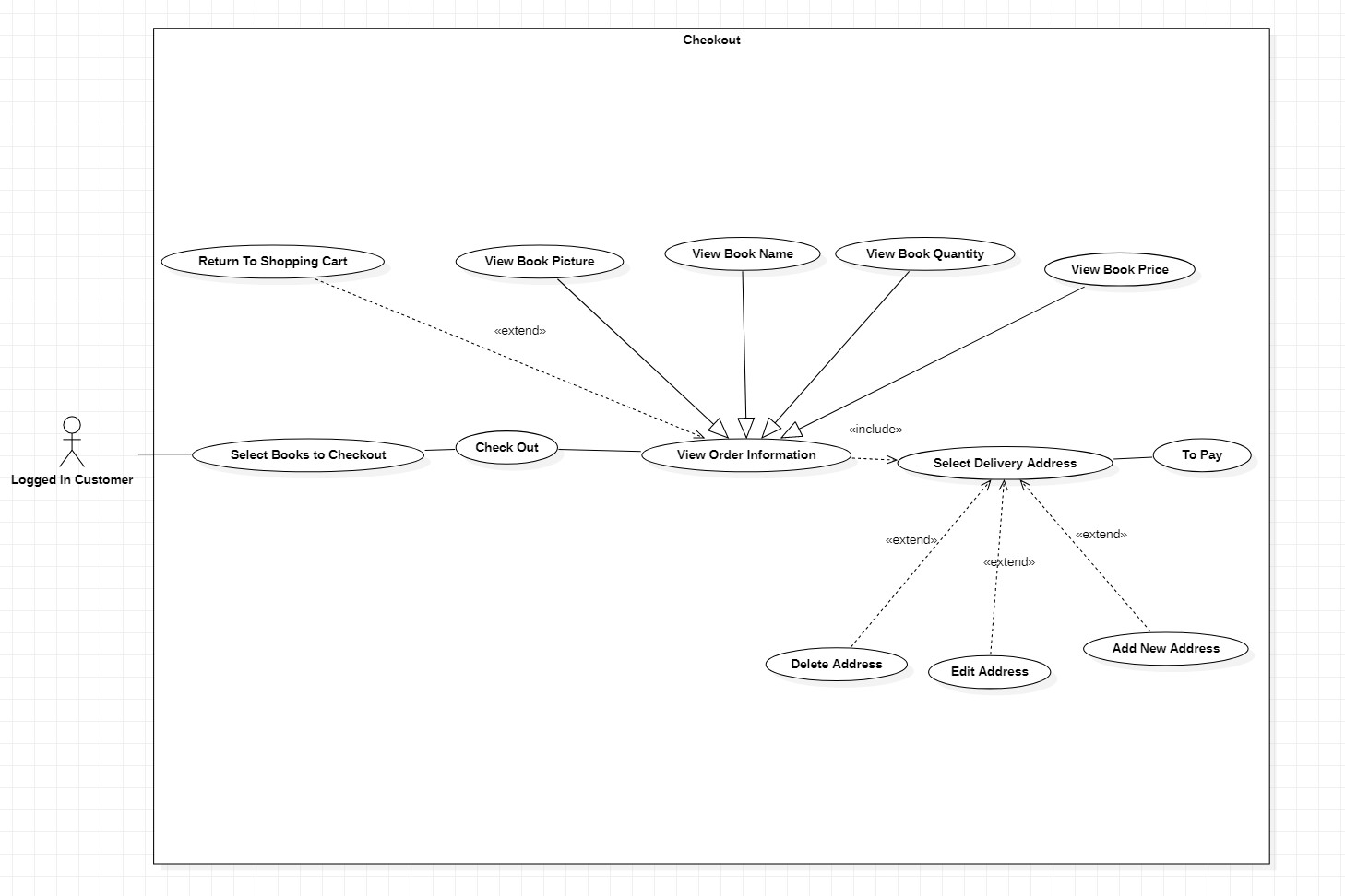
Check Out
Logged in customer may select books and then checkout. After that, customer can view order information including book picture, name, quantity and price. And customer must select delivery address before payment. The operation to address include add, edit and delete.

Slide 11
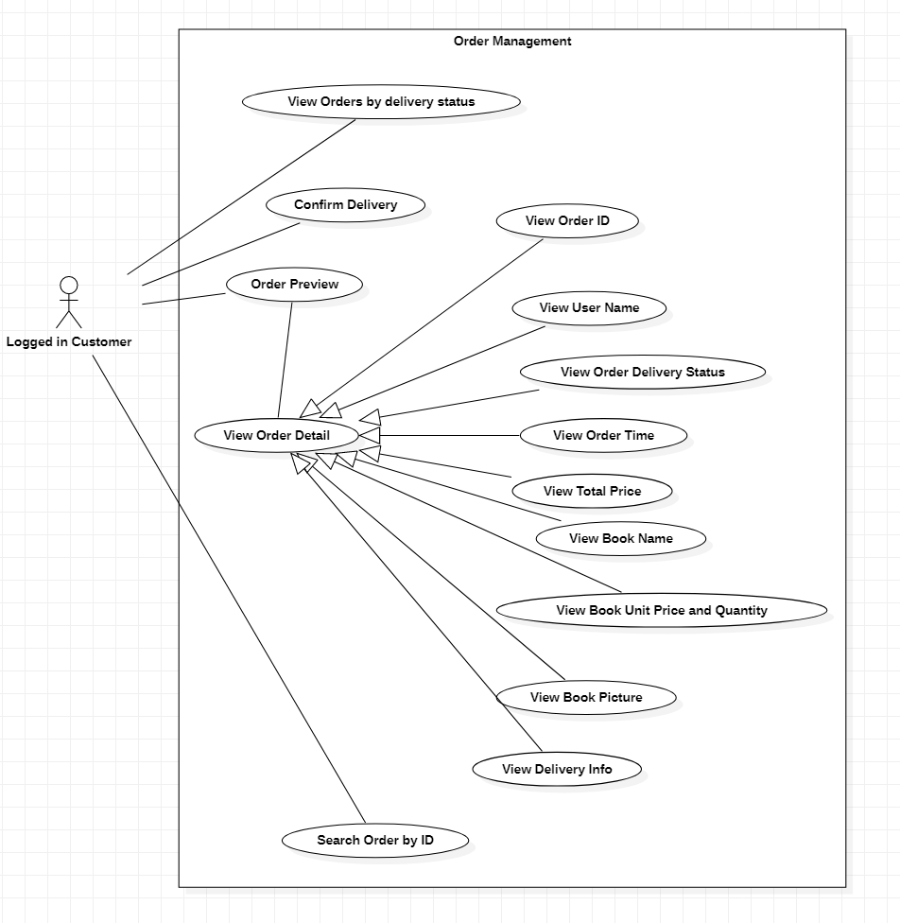
Order Management
Logged in customer can preview order and view order details include order ID, user name, order delivery status, order time, total price, book name, book unit price, quantity and picture, and delivery infomation as well.
Besides, customer can view orders by delivery status, confirm delivery, and search order by ID if needed.

Slide 12
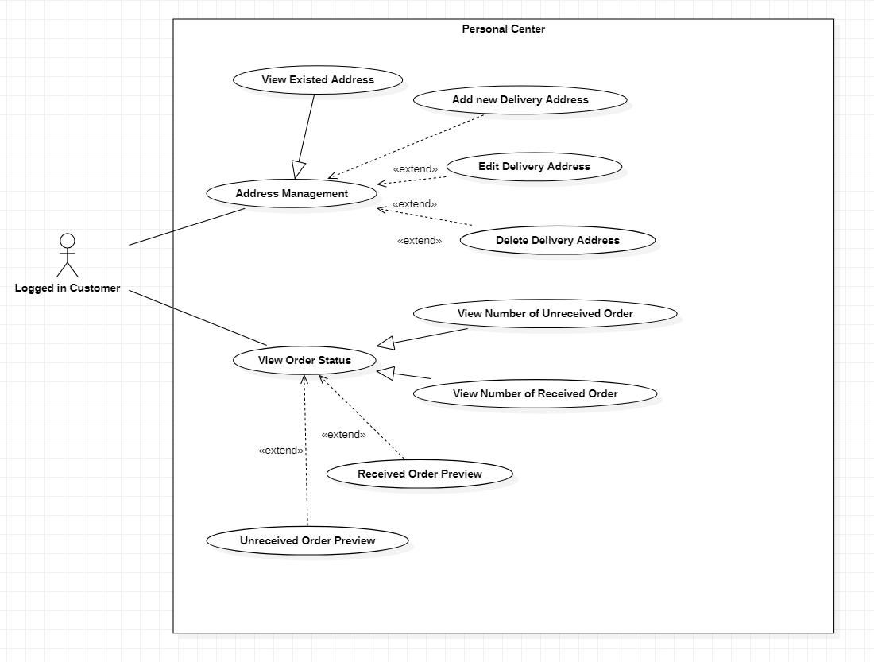
Personal Center
Logged in customers can view existed address and manage their address by adding new delivery address and also editing and deleting it.
And customer can view order status including the number of received and unreceived order and preview these two orders.

Slide 13
Background Requirement
User Management
Book Management
Category Management

Slide 14
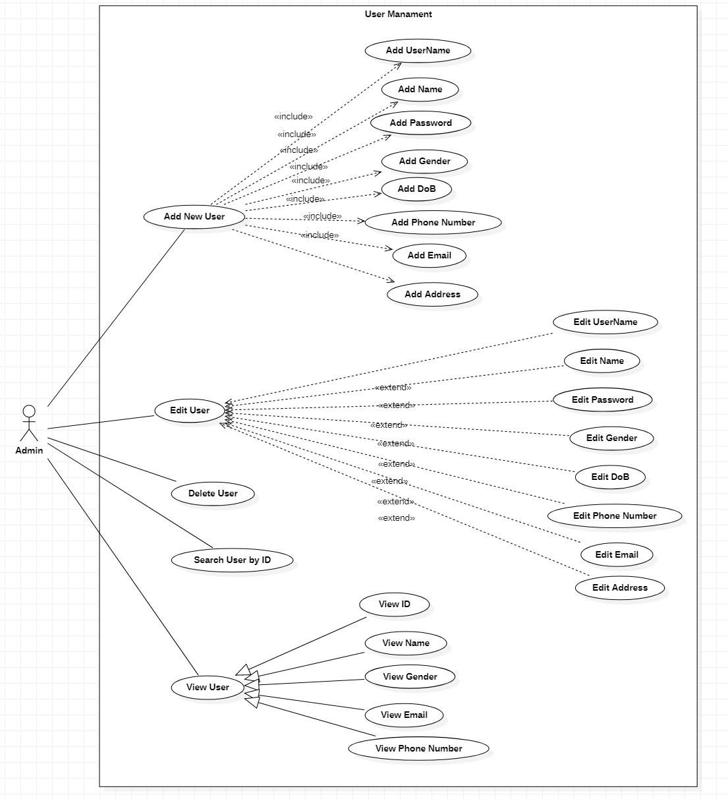
User Management
Admin can add, edit and delete the users. The addible and editable properties are username, name, password, gender, dob, phone number, email and address of user.
Admin can search user by ID and view user’s ID, name, gender, email and phone number.

Slide 15
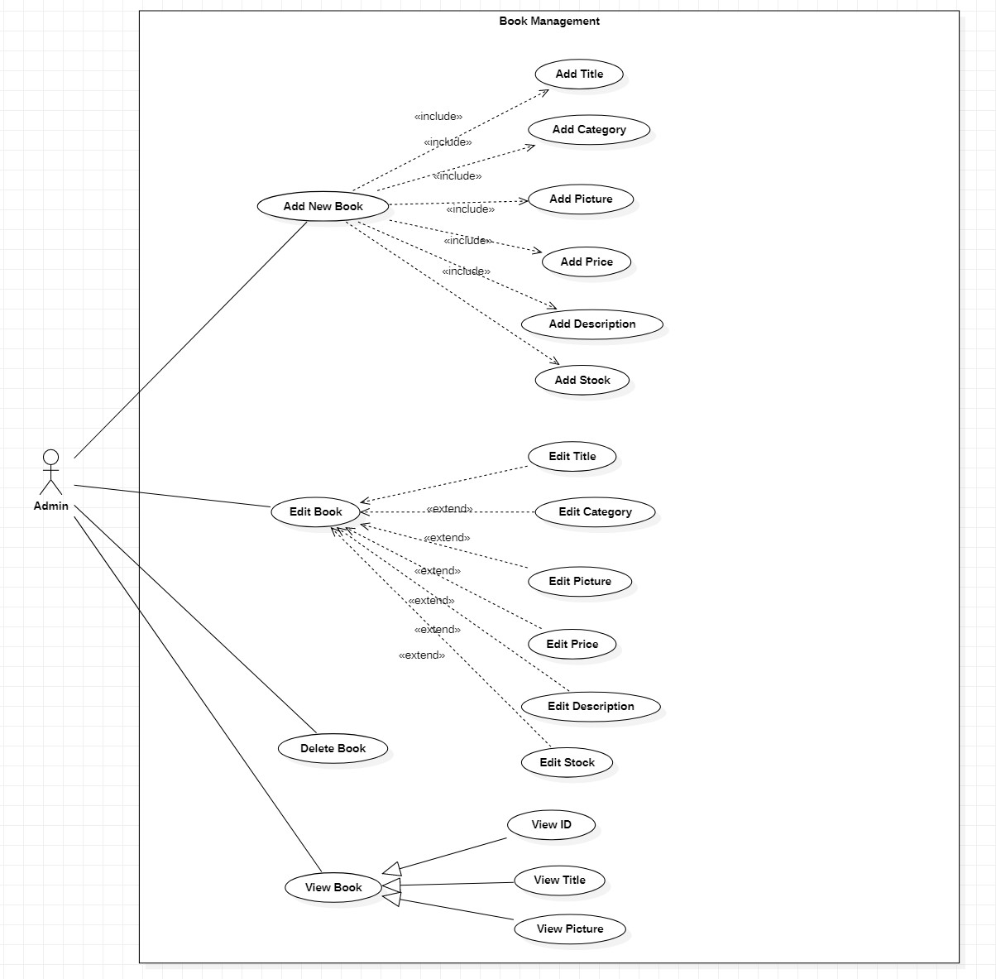
Book Management
Admin can add, edit and delete the books. The addible and editable properties are title, category, picture, price, description and stock of book. The ID, title and picture of book can also be viewed.

Slide 16
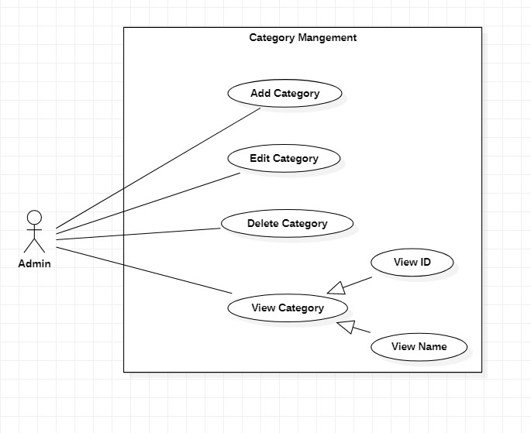
Category Management
Admin can add, edit and delete general book category (classification of books). The ID and name of category can also be viewed by admin.

Slide 17
Recommendation & Conclusion
customer comment function
Function
enable customers to modify personal information by themselves
User Experience
the payment management system
Payment
Push the project online
Online

